Slide 1
A Case Study for Improving Network Isolation in a Multi-tenant Kubernetes Cluster
Ardalan Kangarlou (NetApp)
Neha Aggarwal (Microsoft)

Slide 2


Bonjour!
Ardalan Kangarlou
NetApp
Distinguished Engineer
Neha Aggarwal
Microsoft
Principal Group Engineering Manager

Slide 3
Agenda
Kubernetes Multitenancy.
State of Network multi-tenancy that exists today.
Adding Network isolation on a shared Multitenant cluster.
Demo
Q&A

Slide 4
What is Multi-tenancy?
One definition for multi-tenancy:
Running multiple instances of the same application or different applications with some level of isolation using a shared infrastructure
Motivation
Lower cost and higher scale for IaaS, PaaS, SaaS, and serverless computing
Key multi-tenancy enablers in the last two decades:
Virtualization and containerization
Considerations
Security and privacy
"Zero trust"
"Defense in Depth": Leverage multiple security measures/layers to protect assets (no silver bullets)
The noisy neighbor problem
Isolating resource consumption and interference in a shared environment

Slide 5
Multi-Tenancy in Kubernetes
Compute
Linux namespaces and cgroups
Sandbox pods (e.g., Kata containers, gVisor or HyperV) for untrusted applications
Storage
Namespaced PersistentVolumeClaim and VolumeSnapshot vs. non-namespaced PersistentVolume and VolumeSnapshotContent
Protocol- and platform-specific techniques for authentication and limiting volumes/files access
Networking
The focus of this talk and more on this later
Kubernetes control plane
Kubernetes namespaces, service accounts, and RBAC to limit access to Kubernetes objects

Slide 6
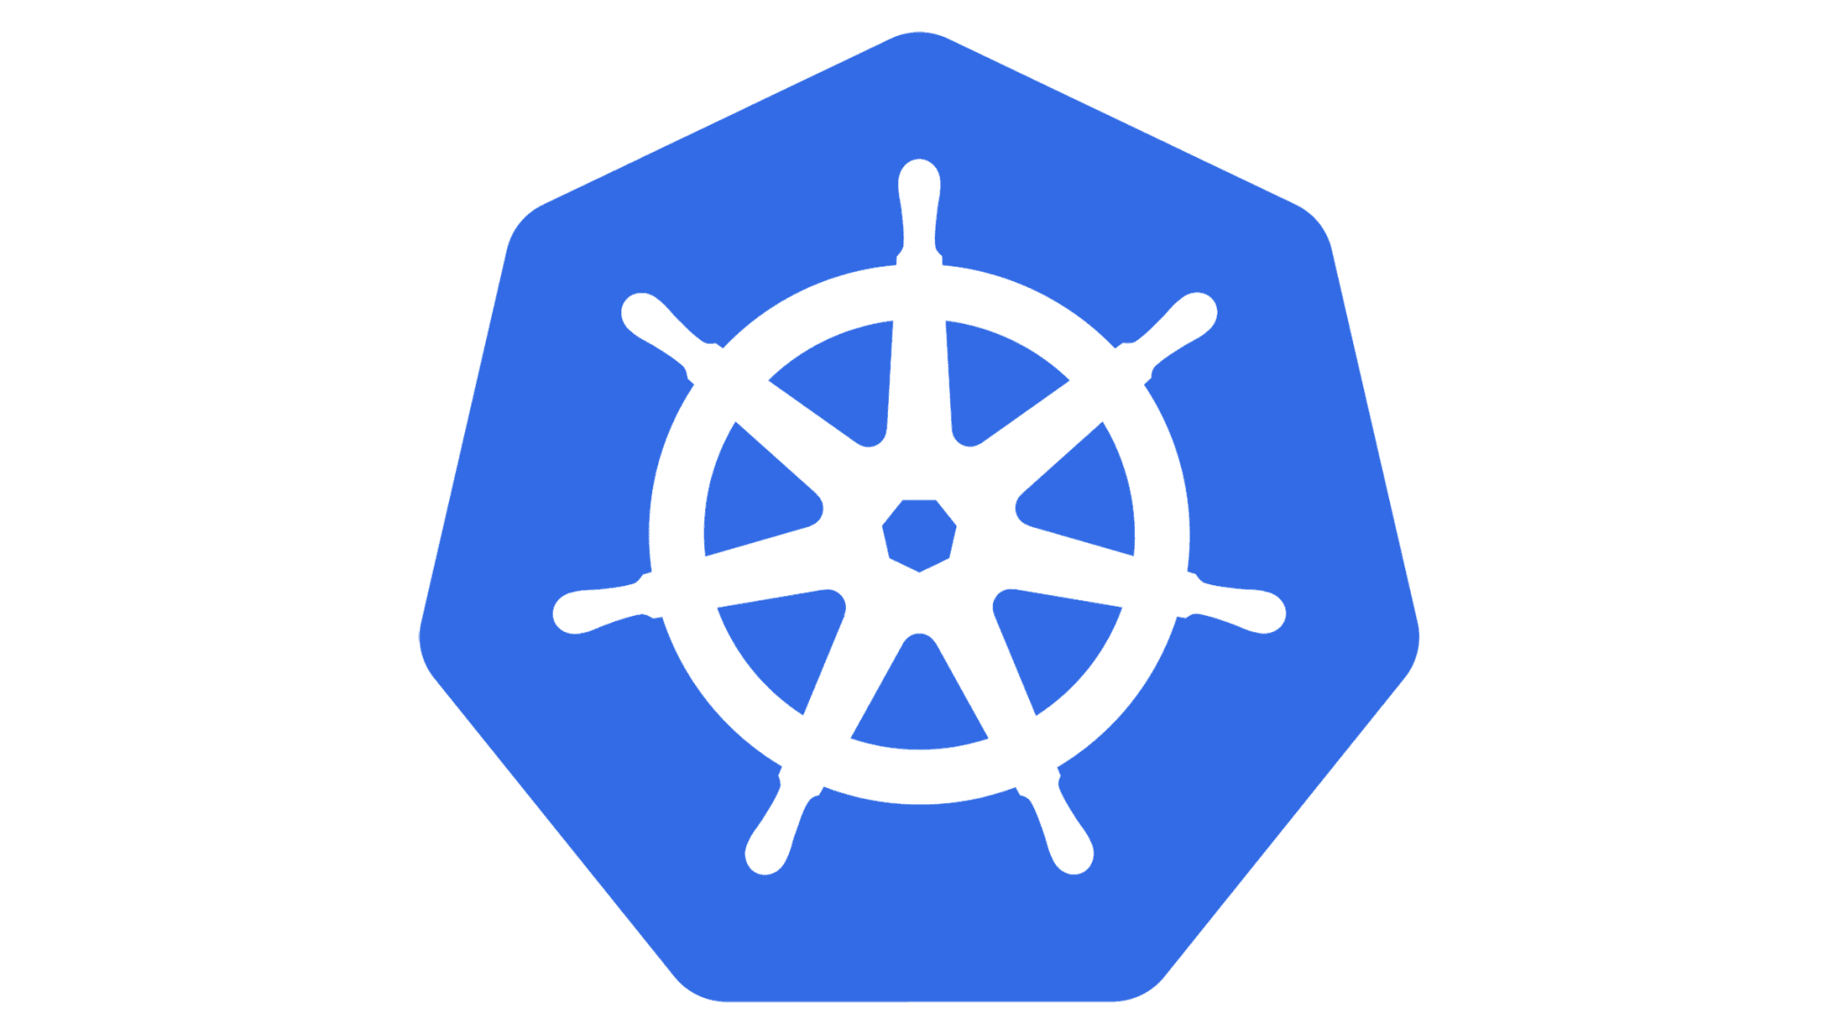


The Classic Multi-Tenancy Example
The "Red Soda" and "Blue Soda" pods running in the same Kubernetes cluster
SodaDB: https://github.com/kangarlou/sodadb
A toy, in-memory JSON over HTTP key-value store to demonstrate network connectivity in Kubernetes
SodaDB supports adding, updating, getting, listing, and deleting records using a REST API:
Create and update:
curl --header "Content-Type: application/json" --header "Accept: application/json" -X POST -s 10.1.0.5:8080 -d '{"id":0, "brand":"RedClassic", "revenue":1000000000, "soda_formula":"???????????"}'
Get:
curl -X GET 10.1.0.5:8080/record-id
Delete:
curl -X DELETE 10.1.0.5:8080/record-id
List:
curl -X GET 10.1.0.5:8080/
Master
Worker Node
Worker Node
SodaDB
Pod
SodaDB
Pod
Worker Node
SodaDB
Pod
SodaDB
Pod

Slide 7
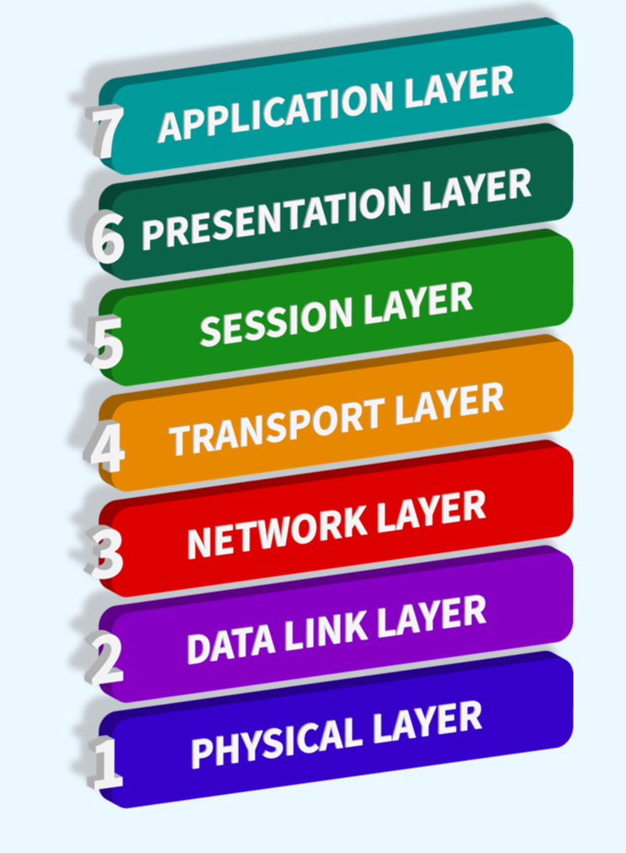
Kubernetes Network Multi-Tenancy
Some widely-used concepts:
Pod networking
Network Policy
Service Mesh
… (and introducing a new concept today: "multi-network pods")
Revisiting "Defense in Depth":
Scope:
Within a Kubernetes node vs. across nodes
Within a Kubernetes cluster vs. across clusters
Layer:
Implementation at what layer(s) of the OSI model

Slide 8
Kubernetes Networking Principles
A flat, shared networking namespace between pods and hosts
Enable full network communication between all the hosts and pods in the Kubernetes cluster
Facilitate self-registration for service discovery
One IP address per pod as opposed to one per container
Compatible with the VM networking model
Simplifies dynamic port allocation
Worker Node
Pod
Master
Worker Node
Worker Node
Pod
Pod

Slide 9
Pod Networking by Example –
Same Node Multi-tenancy
$ kubectl get pods -A -o wide | grep -E 'red|blue'
red sodadb-red-7f8cf4449-qxx4g 1/1 Running 0 26h 29.23.131.6 node1 <none> <none>
blue sodadb-blue-cfb868d94-9lsdk 1/1 Running 0 26h 29.23.131.14 node1 <none> <none>
$ root@node1 ~ $ ps -aux | grep sodadb | grep -v grep
root 9025 0.0 0.0 1229552 5188 ? Ssl Mar05 0:00 /root/sodadb -company=Red-Soda -network_interface=eth0
root 9623 0.0 0.0 1229552 5180 ? Ssl Mar05 0:00 /root/sodadb -company=Blue-Soda -network_interface=eth0
$ root@node1 ~ $ ls -l /proc/9025/ns/
total 0
lrwxrwxrwx 1 root root 0 Mar 6 18:23 cgroup -> 'cgroup:[4026532278]'
lrwxrwxrwx 1 root root 0 Mar 6 18:23 ipc -> 'ipc:[4026532913]'
lrwxrwxrwx 1 root root 0 Mar 6 18:23 mnt -> 'mnt:[4026532276]'
lrwxrwxrwx 1 root root 0 Mar 6 18:23 net -> 'net:[4026532583]'
lrwxrwxrwx 1 root root 0 Mar 6 18:23 pid -> 'pid:[4026532277]'
lrwxrwxrwx 1 root root 0 Mar 6 21:54 pid_for_children -> 'pid:[4026532277]'
lrwxrwxrwx 1 root root 0 Mar 6 21:54 time -> 'time:[4026531834]'
lrwxrwxrwx 1 root root 0 Mar 6 21:54 time_for_children -> 'time:[4026531834]'
lrwxrwxrwx 1 root root 0 Mar 6 21:54 user -> 'user:[4026531837]'
lrwxrwxrwx 1 root root 0 Mar 6 18:23 uts -> 'uts:[4026532912]'
$ root@node1 ~ $ ls -l /proc/9623/ns/
total 0
lrwxrwxrwx 1 root root 0 Mar 6 21:56 cgroup -> 'cgroup:[4026533454]'
lrwxrwxrwx 1 root root 0 Mar 6 21:56 ipc -> 'ipc:[4026533331]'
lrwxrwxrwx 1 root root 0 Mar 6 21:56 mnt -> 'mnt:[4026533452]'
lrwxrwxrwx 1 root root 0 Mar 6 21:56 net -> 'net:[4026533187]'
lrwxrwxrwx 1 root root 0 Mar 6 21:56 pid -> 'pid:[4026533453]'
lrwxrwxrwx 1 root root 0 Mar 6 21:56 pid_for_children -> 'pid:[4026533453]'
lrwxrwxrwx 1 root root 0 Mar 6 21:56 time -> 'time:[4026531834]'
lrwxrwxrwx 1 root root 0 Mar 6 21:56 time_for_children -> 'time:[4026531834]'
lrwxrwxrwx 1 root root 0 Mar 6 21:56 user -> 'user:[4026531837]'
lrwxrwxrwx 1 root root 0 Mar 6 21:56 uts -> 'uts:[4026533330]'
The network namespaces

Slide 10
Pod Networking and the Pause Container
root@node1 ~ $ lsns -u -t net -o NS,PATH,PID,PPID,NETNSID,NSFS,PNS | grep 4026532583
4026532583 /proc/7763/ns/net 7763 7690 4 /run/netns/cni-18112408-5a93-c0ed-3904-6844931ddd85 0
root@node1 ~ $ cat /proc/7763/cmdline
/pause
Red SodaDB pod's network namespace ID
Pause container as the owner of the Red pod's network namespace
root@node1 ~ $ ls -l /proc/7763/ns/
total 0
lrwxrwxrwx 1 65535 65535 0 Mar 6 22:57 cgroup -> 'cgroup:[4026531835]'
lrwxrwxrwx 1 65535 65535 0 Mar 5 19:14 ipc -> 'ipc:[4026532913]'
lrwxrwxrwx 1 65535 65535 0 Mar 6 22:57 mnt -> 'mnt:[4026532911]'
lrwxrwxrwx 1 65535 65535 0 Mar 5 19:14 net -> 'net:[4026532583]'
lrwxrwxrwx 1 65535 65535 0 Mar 6 22:57 pid -> 'pid:[4026532914]'
lrwxrwxrwx 1 65535 65535 0 Mar 6 22:57 pid_for_children -> 'pid:[4026532914]'
lrwxrwxrwx 1 65535 65535 0 Mar 6 22:57 time -> 'time:[4026531834]'
lrwxrwxrwx 1 65535 65535 0 Mar 6 22:57 time_for_children -> 'time:[4026531834]'
lrwxrwxrwx 1 65535 65535 0 Mar 6 22:57 user -> 'user:[4026531837]'
lrwxrwxrwx 1 65535 65535 0 Mar 5 19:14 uts -> 'uts:[4026532912]'
root@node1 ~ $ ip netns exec cni-18112408-5a93-c0ed-3904-6844931ddd85 ip a
1: lo: <LOOPBACK,UP,LOWER_UP> mtu 65536 qdisc noqueue state UNKNOWN group default qlen 1000
link/loopback 00:00:00:00:00:00 brd 00:00:00:00:00:00
inet 127.0.0.1/8 scope host lo
valid_lft forever preferred_lft forever
3: eth0@if8: <BROADCAST,MULTICAST,UP,LOWER_UP> mtu 1460 qdisc noqueue state UP group default qlen 1000
link/ether 9e:fb:4f:1c:60:4b brd ff:ff:ff:ff:ff:ff link-netnsid 0
inet 29.23.131.6/32 scope global eth0
valid_lft forever preferred_lft forever
Red SodaDB pod's IP address

Slide 11
Network Policy –
Same Cluster Multi-tenancy
Network Policy
Specifies the rules to control ingress and egress traffic for pods.
The NetworkPolicy API has been around for a while:
Alpha: v1.2, Beta: v1.3, and GA: v1.7
Requires CNI plugin support (e.g., Calico, Cilium, Azure CNI, Amazon VPC, GKE Dataplane V2)
Operating at L3 and L4 in the OSI model
Example policies
Only allow communication within namespaces "redsoda" and "bluesoda" (but not across them)
Allow communication between "frontend" and "backend" pods but not between other pods
SodaDB
Pod
SodaDB
Pod

Slide 12
Service Mesh
Scope: Same or different clusters/networks
An infrastructure layer to manage communication between, to, and from microservices
Traffic management via authorization policies and rate limiting (especially for L7 traffic)
Security (mTLS) via authentication policies
A typical multi-tenant scenario with a service mesh:
Many app teams (tenants) managing a distinct set of microservices
The tenant apps may or may not talk to each other.
Platform teams managing a common infrastructure for app teams
Platform teams can consist of Kubernetes admins, network admins, and/or security ops.
Web Interface Microservices
Storage Microservices
Ingress Gateway
Online Payment Microservices

Slide 13
The Challenges with building multi-tenant cloud services based on Kubernetes
Network namespaces and cgroups help with isolation within a node
Network policies help with isolation only between Kuberenetes pods
Service mesh can help with isolation across clusters and networks but with the following caveats:
It requires public/private gateways to multiplex traffic into different microservices.
A mixed VM-Kubernetes mesh works with gRPC-based applications.
More suited for HTTP/gRPC applications

Slide 14
Network Multi-Tenancy for Managed Cloud Services Built on Kubernetes
The current state of the art: Not a true multi-tenant Kubernetes setup
Managed Cloud Services
Red Project/Subscription
Service Project/Subscription
Red VPC/VNet
VPC/VNet
VPC/VNet Peering
Subnet
Load Balancer Subnet
Pod Subnet
Blue Project/Subscription
Service Project/Subscription
Blue VPC/VNet
VPC/VNet
VPC/VNet Peering
Load Balancer Subnet
Subnet
Pod Subnet

Slide 15
How to get Network Isolation in a shared multitenant cluster?

Slide 16
What we wanted to achieve?
Share Kubernetes cluster to host Multi-Network, Multi-Tenant workloads.
Today, All Pods are provisioned with single interface aka “Default Network”.
Default cluster wide Pod-Pod networking.
Allow Pods to provision an additional interface from different network aka “Pod/Customer Network”
Allows private access to other workloads running in Customer Network across shared cluster
Saves cost without compromising security!
Hosted Service Tenant
Kubernetes worker node
Customer Pod
eth0
eth1
Default Cluster-wide network
192.168.0.6
10.0.0.7
Customer Tenant
Customer Network

Slide 17
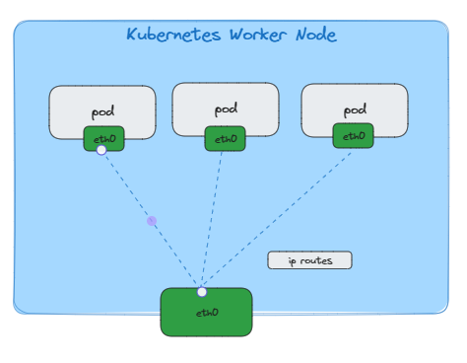
What are the Challenges
kubelet is not aware of Multi-Network Pods.
It expects only single Interface (multiple ips) to be attached to a Pod.
kube-scheduler doesn’t know which Node will satisfy Multi-Network Pod needs.
Workaround: Manual scheduling by adding NodeSelectors in PodSpec. Not Scalable!

Slide 18
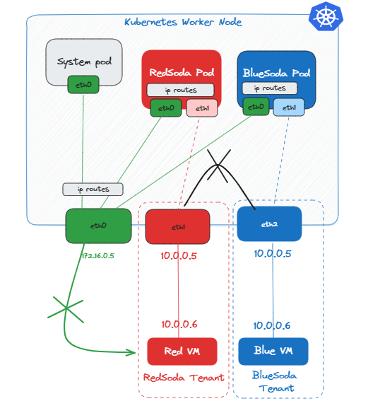
How we are addressing it.
Extend CNI to attach secondary interface on a Multi-Network Pods.
Today, Kubernetes node is provisioned with single interface.
Allows additional interfaces into the Node for each different network.
When a Multi-network Pod gets deployed then provision the Node’s interface with customer network and project them into PodNetwork Namespace.
Trusted Code running in a process isolated containers. Untrusted can be isolated via Kata/Hyperv/gVisor.
Later, we have used Device Plugins to make Node’s multi network interfaces first class resource for kube-scheduler.

Slide 19
Details of CNI Extensions
Kubernetes API
Kubernetes worker node
kube-api
CRD based approach to define Pod/Customer networks.
Multi-Network Pod will be labeled referencing the CRD.
North star KEP 3698 – Multi Network.
Pod Network CRD
BlueSoda Network
blueSoda Pod
blueSoda Pod
eth0
eth1
CNI
labels:
podNetwork: blueSoda
kubelet
eth0
eth1

Slide 20
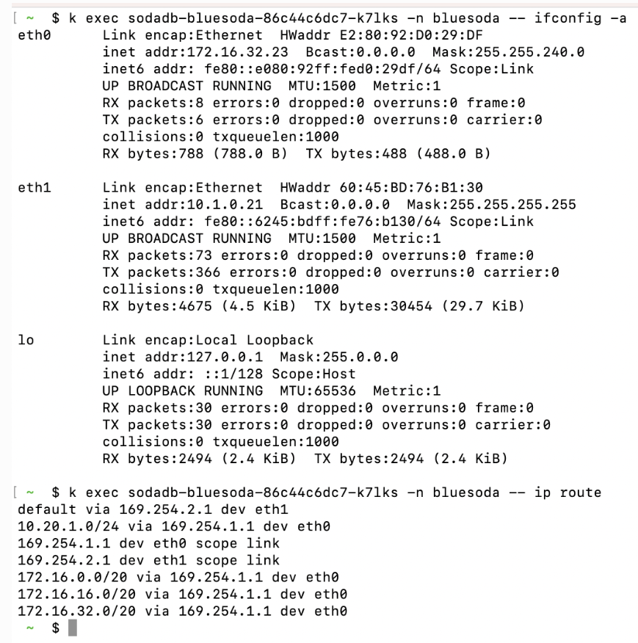
Details of CNI Extensions
kube-api
Kubernetes worker node
Deploy PodNetwork CRD
Pod Network CRD
BlueSoda Network
Gets Customer Network Interface info
Configure ip routes
Status: Ready
blueSoda Pod
Deploy Multi-Network Pod
blueSoda Pod
eth0
eth1
CNI
labels:
podNetwork: blueSoda
Move Node eth1 into PodNetwork Namespace
kubelet
Multi-Network Pod Scheduled
eth0
eth1
172.16.32.23
10.1.0.21

Slide 21
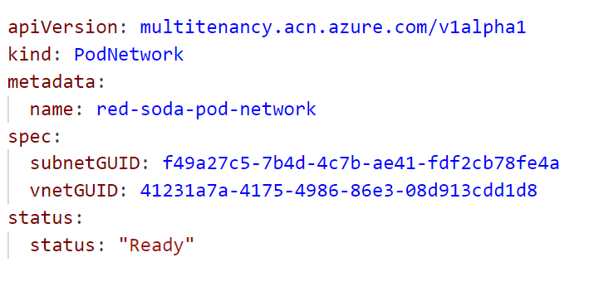
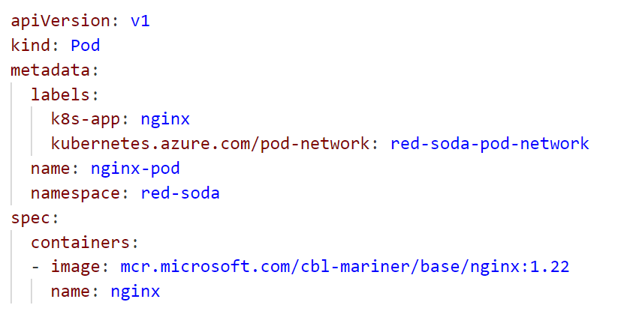
PodNetwork and Pod Manifests
PodNetwork defines the customer’s network
Pod has a label which references the PodNetwork so CNI knows to attach a second NIC

Slide 22
Details of kube-scheduler Extensions
Kubernetes API
Kubernetes worker node
In our solution, Nodes are provisioned with additional Interfaces.
Nodes added with additional interfaces can only host Multi-Network Pods.
Need to make kube-scheduler aware of these additional available interfaces on Node.
This can be achieved via DevicePlugin. Advertise additional interfaces as available resources for multi-network pods.
kube-scheduler will now deploy multi-network to only those nodes that can satisfy the need.
kube-api
Pod Network CRD
BlueSoda Network
Allocate blueSodaApp
Multi-Network
Device Plugin
blueSoda Pod
List 1 network/nic available
blueSoda Pod
eth0
eth1
CNI
labels:
podNetwork: blueSoda
Spec:
containers:
resources:
limits:
network/nic: 1
kubelet
eth0
eth1
kube-scheduler

Slide 23
Demo: "Multi-network Pods"
https://github.com/kangarlou/sodadb/demo
SodaDB as a Service
Kubernetes Cluster
RedSoda VNet
Infra VNet
Subnet
Infra
Subnet
redsoda-client
VM
eth1
SodaDB
Pod
eth1
eth0
eth0
BlueSoda VNet
Subnet
bluesoda-client
VM
eth1
SodaDB
Pod
eth0

Slide 24
Q&A

Slide 25
Thank You

